Slide 1
EECS 2500 Linear Data Structures
Lecture 03
Chapter 01 – Getting Organized (Part 2)
Fall 2016
Dr. Larry G. Thomas – University of Toledo/LCCC

Slide 2
Last Time
Software Engineering
Definitions / Activities
Software Development Life Cycles
Waterfall, Spiral, Agile, Unified
Requirements, Design (hi/lo), coding, testing, delivery, operation, maintenance
Object Orientation (review)
Classes & Objects
Data (attributes / variables) & Behavior (methods)
UML Diagrams
The Date class

Slide 3
Last Time, cont’d
Organizing Classes
Inheritance hierarchy (degrees of specialization)
Packages (related by subject matter)

Slide 4
Data Structures
Section 1.5

Slide 5
1.5: Data Structures
Enough about java itself!
This course if about data structures
We’ve seen a great deal about structuring your programs:
if/then, do/while, for, try/catch blocks
Dividing our solution into classes and methods
What about the structure of the data itself?
For the most part, we’ve used simple variables or arrays for all of our data.
But wait, there’s more!

Slide 6
Data Structures
The way you view and structure the data that your programs manipulate greatly influences your success.
A language's set of primitive types (Java's are byte, char, short, int, long, float, double, and boolean) are not sufficient, by themselves, for dealing with data that have many parts and complex interrelationships among those parts.
Data structures provide this ability.

Slide 7


Implementation-Dependent Structures
Array Linked List

Slide 8
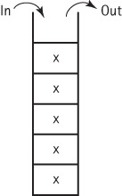


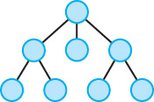
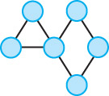
Implementation-Independent Structures
Queue
Stack
Sorted List
Tree
Graph

Slide 9
Basic Structuring Mechanisms
Section 1.6

Slide 10
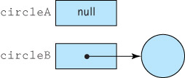
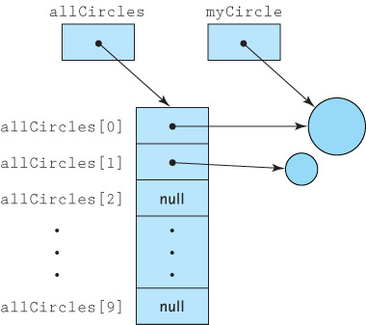
1.6: Basic Structuring Mechanisms
There are two basic structuring mechanisms provided in Java (and many other high level languages) – Arrays and References
References
Arrays

Slide 11
References
Are memory addresses (locations)
Sometimes referred to as links, addresses, or pointers (particularly in C/C++)
Java uses the reserved word null to indicate an “absence of reference” or “this reference value doesn’t refer to anything at this time”
A variable of a reference (non-primitive) type holds the address of the memory location that holds the value of the variable, rather than the value itself.
This has several ramifications …

Slide 12
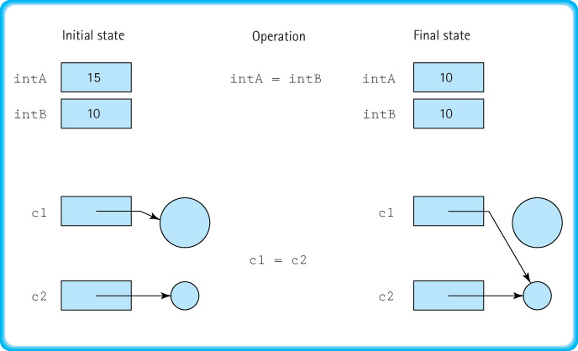
Assignment Statements

Slide 13
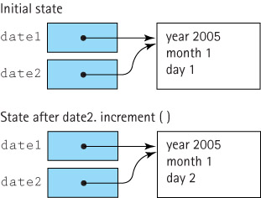
Be Aware of (Beware of) Aliases!

Slide 14
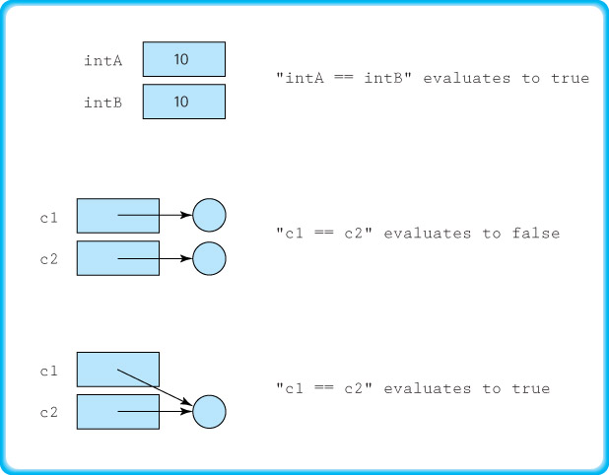
Comparison Statements

Slide 15
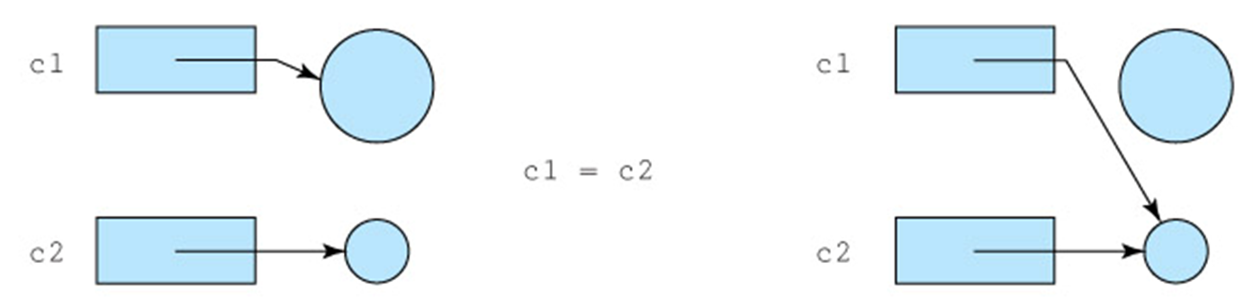
Garbage
Reconsider this situation:
After the assignment statement, the larger circle has nothing referencing it; therefore, there is no way to access it, so it is “floating in limbo”, just taking up (wasting) memory
It is garbage.

Slide 16
Garbage Management
Garbage: the set of currently unreachable objects
Garbage collection: the process of finding all unreachable objects and deallocating (reclaiming) their storage space
Deallocate: to return the storage space for an object to the pool of free memory so that it can be reallocated to new objects
Dynamic memory management: the allocation and deallocation of storage space as needed while an application is executing

Slide 17
Arrays
I assume that you are already familiar with arrays. The subsection on pages 38 to 41 reviews some of the subtle aspects of using arrays in Java:
They are handled “by reference”
They must be instantiated (because they’re objects)
Initialization lists are supported
You can have arrays of objects (references to objects)
You can use multi-dimensional arrays
See chapters 6-7 of the Java text from EECS 1510

Slide 18
Comparing Algorithms (Big-O Analysis)
Section 1.7

Slide 19
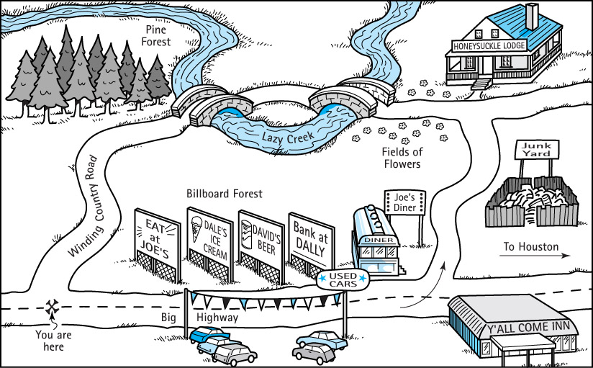
Comparing Algorithms: Big-O Analysis
There can be more than one algorithm that will solve a problem. “How to get to Joe’s Diner?”

Slide 20
Algorithm Analysis
Just as there can be more than one algorithm that will solve a problem, there are multiple ways to analyze an algorithm:
How long (Wall Clock time) will it require to run?
Depends on clock speed, what else is running, etc – factors that have nothing to do with the algorithm itself
How long (CPU time) will it require to run?
Doesn’t depend on what else is running, but still depends on the CPU clock speed, instruction set, compiler, etc.
What other resources (disk, memory, etc.) will it require to run?

Slide 21
Counting Operations
Typically, we analyze (theoretical) run time by isolating the fundamental operations that occur in the algorithm, and counting those.
To measure the complexity of an algorithm we attempt to count the number of basic operations required to complete the algorithm
To make our count generally usable, we express it as a function of (in terms of) the size of the problem.

Slide 22
Counting Operations - Example
Problem: return true if sum of numbers in array is > 0, false otherwise
set sum to zero
while more integers
set sum to
sum + next integer
if sum > 0
return true
else
return false
If N = size of array, then the number of operations required is (2N – 1) + 3, or 2N+2
But:
Too dependent on programming language and counting approach
Difficult if problem / algorithm is more complicated

Slide 23
Isolate a Fundamental Operation
Rather than count all operations, select a fundamental operation, an operation that is performed “the most”, and count it.
Example: If the problem is to sort the elements of an array, count the number of times one element is compared to another element, i.e., only count comparison operations when comparing sorting algorithms.

Slide 24
A Further Simplification: Big-O Notation
We measure the complexity of an algorithm as the number of times a fundamental operation is performed, represented as a function of the size of the problem.
For example, a sorting algorithm performed on an N-element array may require 2N² + 4N + 3 comparisons.

Slide 25
A Further Simplification: Big-O Notation
Big-O notation expresses computing time (complexity) as the term in the function that increases most rapidly relative to the size of a problem.
In our example, rather than saying the complexity is 2N² + 4N + 3, we say it is O(N²).
Pronounced “Order-N-Squared” or “Big-O of N-Squared”
This works just as well for most purposes and simplifies the analysis and use of the complexity measure.

Slide 26
Common Orders of Magnitude (1)
O(1) is called bounded time or constant time. The amount of work is not dependent on the size of the problem, and is bounded by (no greater than) some constant.
O(log₂N) is called logarithmic time. Algorithms that successively cut the amount of data to be processed in half at each step typically fall into this category (Price Is Right’s “Hi-Lo Game”)
O(N) is called linear time: If the problem gets twice as large, it takes twice as long to solve. Summing the elements of an array is O(N).

Slide 27
Common Orders of Magnitude (2)
O(N log₂N) is called N log N time. Good sorting algorithms, such as Quicksort, Heapsort, and Mergesort presented in Chapter 10, have N log N complexity. Most of these are covered in depth in EECS 2510.
O(N²) is called quadratic time. Most of the simple sorting algorithms are O(N²) algorithms. When the problem becomes twice as large, it takes 4 times as long to solve (10 x size → 100 x time)
O(2^{N}) is called exponential time. These algorithms are extremely costly (cf. O(N²)).

Slide 28
Comparison of Growth Rates
N | log₂N | N log₂N | N² | N³ | 2^{N}
1 | 0 | 1 | 1 | 1 | 2
2 | 1 | 2 | 4 | 8 | 4
4 | 2 | 8 | 16 | 64 | 16
16 | 4 | 64 | 256 | 4,096 | 65,536
64 | 6 | 384 | 4,096 | 262,144 | 20 digits long
128 | 7 | 896 | 16,384 | 2,097,152 | 39 digits long
256 | 8 | 2,048 | 65,536 | 16,777,216 | 78 digits long
One day = 86,400 seconds (5 digits)
One week = 604,800 seconds (6 digits)
One year = 31,557,600 seconds (8 digits)
One century = 3,155,760,000 seconds (10 digits)

Slide 29
Three Complexity Cases
Best case complexity: Related to the minimum number of steps required by an algorithm, given an ideal set of input values in terms of efficiency
Average case complexity: Related to the average number of steps required by an algorithm, calculated across all possible sets of input values
Worst case complexity: Related to the maximum number of steps required by an algorithm, given the worst possible set of input values in terms of efficiency
To simplify analysis yet still provide a useful approach, we usually use worst case complexity

Slide 30
Algorithm Analysis
Ways to simplify analysis of algorithms:
Consider worst case only
but average case can also be important
Depending on the values to be sorted, Quicksort CAN perform O(N²), but its average is O(N log N)
Count a fundamental operation
But be careful; make sure it is the most used operation within the algorithm
Use Big-O complexity
especially when interested in “large” problems

Slide 31
Two Algorithms for the Same Problem
Problem: Sum the numbers from 1 through N, for some given value of N:
Algorithm sum1:
int sum = 0;
for (i=1; i<=N; i++)
sum += i;
return sum;
Algorithm sum1 runs in O(N) – Linear Time

Slide 32
An Aside (1)
Legend has it that the elementary school teacher of famed German mathematician Carl Friedrich Gauss wanted to occupy the class for a while for some reason, and asked them to calculate the sum of the numbers from 1 to 100
While his classmates toiled away on computing 1 + 2 + 3 + 4 + 5 + 6…, Gauss thought for a moment and then started working from both ends at once, rather than starting at 1.
He realized that 1 and 100 formed a pair with a sum of 101, 2 and 99 form a pair with a sum of 101, 3 and 98 form a pair with a sum of 101,…

Slide 33
An Aside (2)
Since he was taking the numbers from 1 to 100 in pairs, there must be 50 pairs, and each pair has a sum of 101, so the sum of the 50 pairs must be 101 * 50 = 5050
To his teacher’s astonishment, his answer, calculated in less than a minute, was correct
In general, the sum of the integers from 1 to N is (N+1)*(N/2), or (N² + N)/2, or ½(N² + N) – this expression comes up a lot in computing

Slide 34
Two Algorithms for the Same Problem
Problem (revisited): Sum the numbers from 1 through N, for some given value of N:
Algorithm sum2:
return (N+1)*N/2;
Note: NO for loop – just three calculations, regardless of how big N is
Algorithm sum2 is O(1) – Constant Time

Slide 35
Two Algorithms for the Same Problem
Problem: Finding a number in a phone book containing N entries:
Algorithm Lookup1:
Check First name
while (not successful)
check next name
Algorithm Lookup1 is O(N) – Linear Time

Slide 36
Two Algorithms for the Same Problem
Problem: Finding a number in a phone book containing N entries:
Algorithm Lookup2 (binary search):
current search area = whole book
check middle name in current search area
while (unsuccesful)
if current search area’s middle name > target name
new search area is first half of current search area
else if middle name < target name
new search area is last half of current search area
else
return number from middle name
Algorithm Lookup2 is O(log₂ N) – Logarithmic Time

Slide 37
End of Chapter 1
End of Chapter 1
Next time (Thursday), we’ll start Chapter 2 (ADT’s - Abstract Data Types)
We will implement our stacks, queues, and linked lists as ADTs
Read this chapter carefully

Slide 38
? Questions ?
?? Any Questions ??

